Slide 1
Mission 8 Remix
Create your own project from Mission 8

Slide 2

Warm-up
In your Mission 8 Remix Log, answer the pre-mission preparation questions:
What is a programming skill you want to improve during this remix?

Slide 3
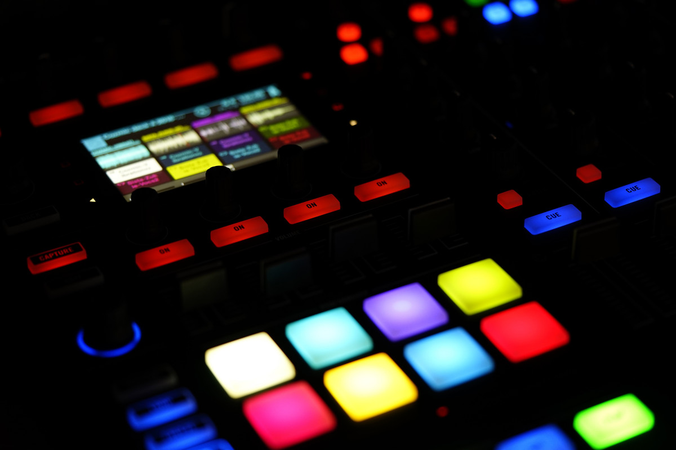
Time for a project remix!
A remix can be:
A new program created by adding new code to a program you already created
You can combine parts of two or more programs in a remix
Use a similar idea in a different way

Slide 4
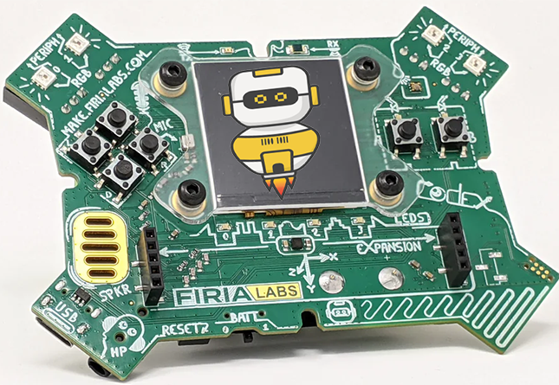
Project Remix
Creating a remix will let you:
Improve your skills and practice the concepts from the mission
Be creative
Remember code from earlier programs and missions
Work with other students
Design an original program and write the code all on your own

Slide 5
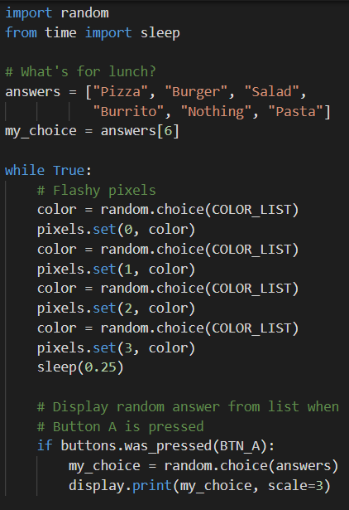
Step #1
Review the mission
Open your project from
Mission 8
  What does the program do?
  What skills were used or concepts learned?
DO THIS:
Fill out the information in the Mission 8 Remix Log for Step 1

Slide 6
Step #2
Brainstorm ideas
Read through remix suggestions from your teacher
Six suggestions are on the next 3 slides. You can use any of these ideas or come up with your own.

Slide 7
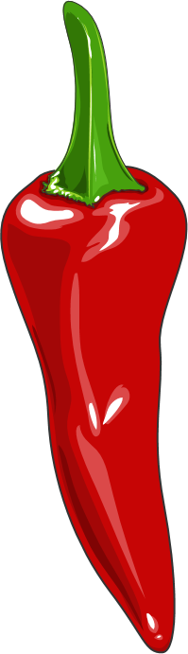
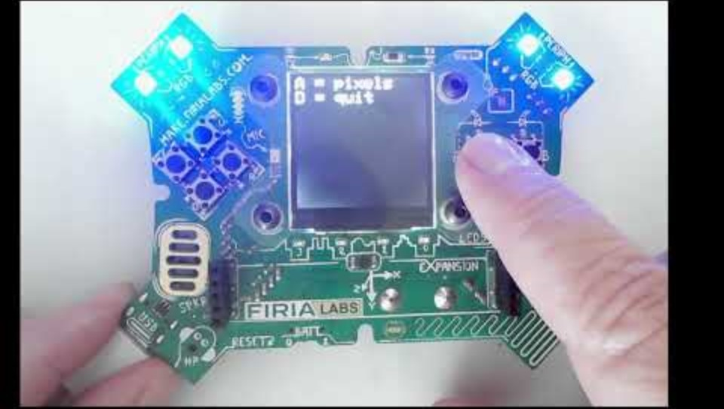
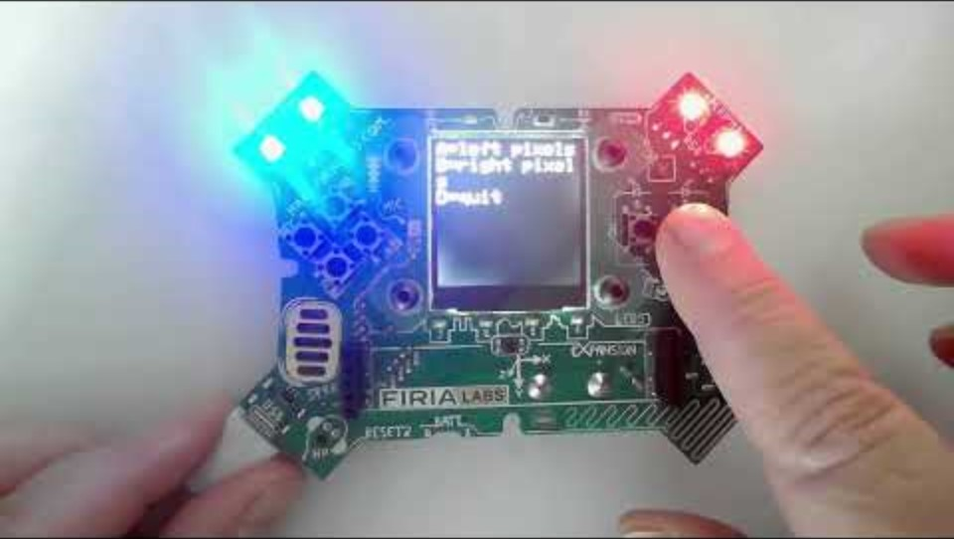
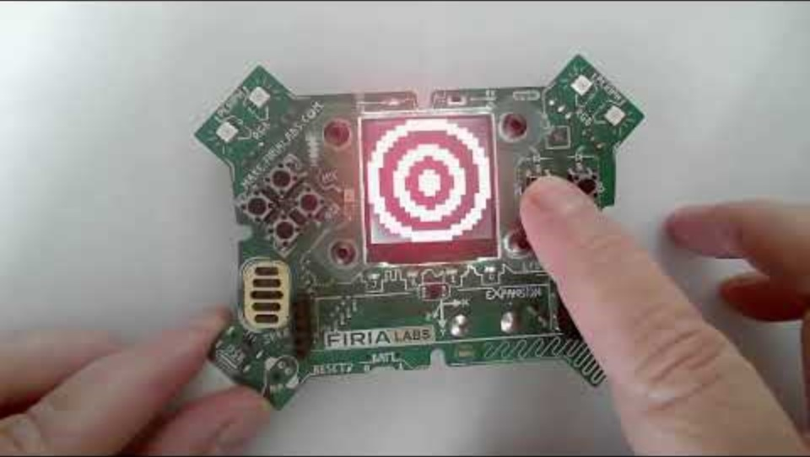
Step #2 Remix Ideas
Mild-1A
Create a list of colors. When a button is pressed, pick a random color and turn on all four pixels. Or use two buttons - Button A for pixels 0 & 1, and
Button B for pixels 2 & 3
Mild-1B
Create a list of images and/or colors. When a button is pressed, pick a random image/color to display. Also program a button to break out of the loop and end the program.

Slide 8
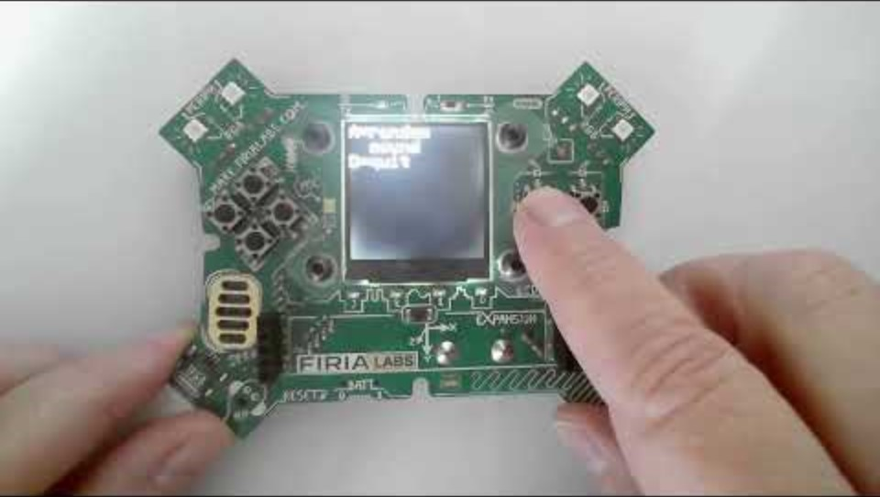
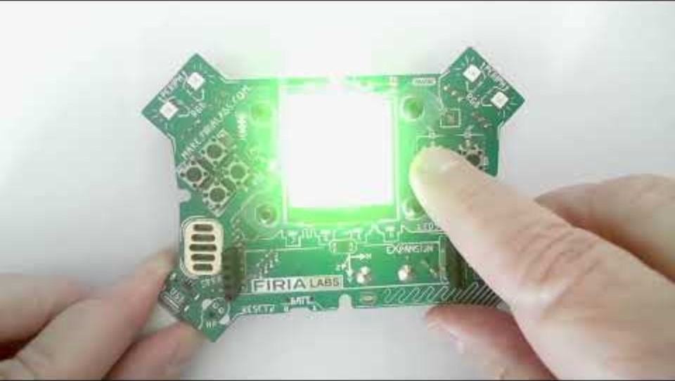
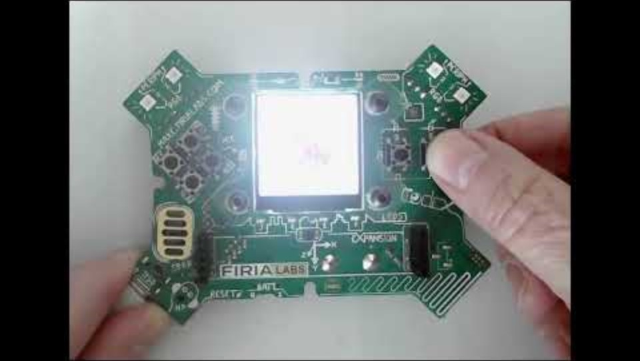
Step #2 Remix Ideas
Medium-2
Create two lists. The items can be colors, text, images or sound. The lists do not need to be similar items or the same size. Use BTN_A for one of the lists and BTN_B for the other list and display a random item from the list when pressed. Program a button to break out of the loop and end the program. Include instructions and “wait” button.
Mild-1C
Create a list of sounds. When a button is pressed, pick a random sound to play. Also program a button to break out of the loop and end the program.

Slide 9
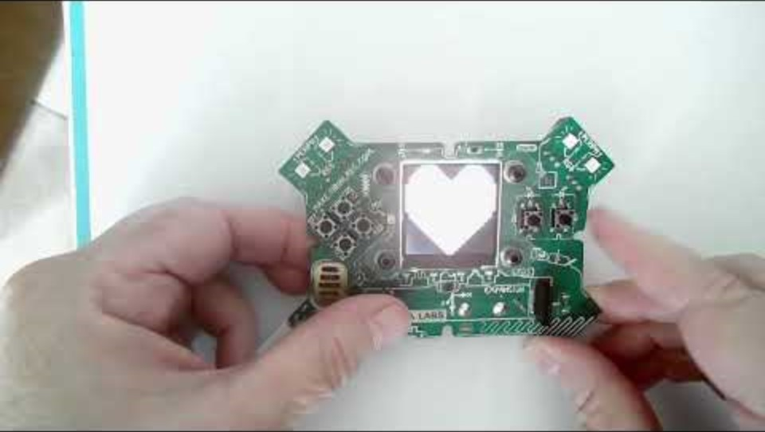
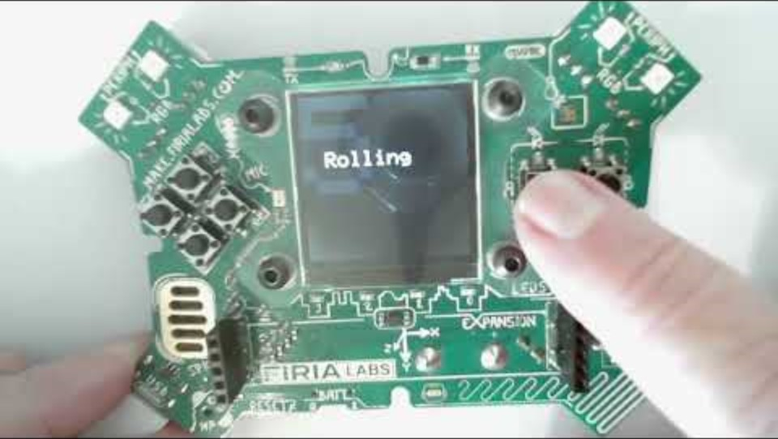
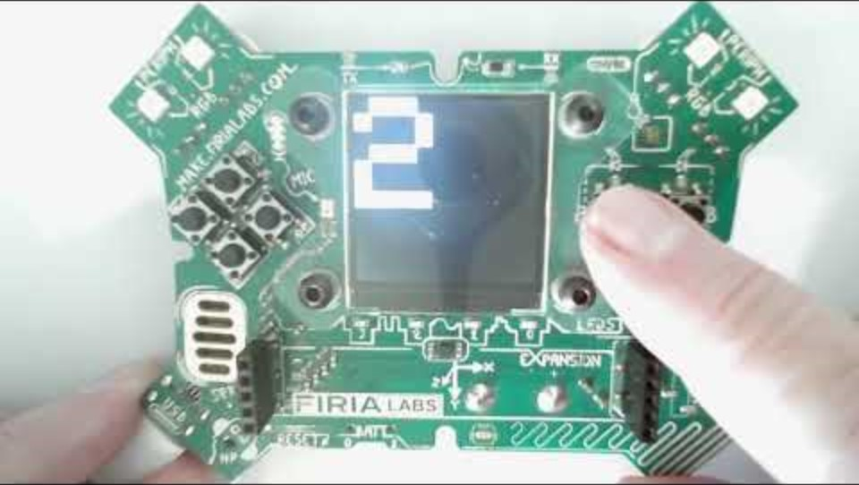
Step #2
Spicy-3B
Create a dice roller, showing the number of a 6-sided die. Change the scale of the text so the number is large. Show a message, like “rolling” before displaying the number.
Spicy-3A
Create 2 different lists, selected with BTN_A and BTN_B buttons. Program BTN_L to scroll backwards, BTN_R to scroll forwards, and BTN_U to select a random item from the chosen list. Include an intro, wait button and exit button.

Slide 10
Step #2
Brainstorm ideas
Read through remix suggestions from your teacher (previous slides)
Use the suggestions as presented, or combine some of the options for your own mild, medium, spicy or extra spicy project
Use your creativity to come up with your own idea for a project
Decide with your partner what project you will do
DO THIS:
Fill out the information in the Mission 8 Remix Log for Step #2

Slide 11
Step #3
Make a plan
What variables will you need? What will you use them for?
What lists will you use, and what will be their items?
What buttons will you program, and what will each button do?
DO THIS:
Fill out the information in the Mission 8 Remix Log for Step #3

Slide 12

Step #4
Code your project
IMPORTANT: In CodeSpace, go to the sandbox
Start with a new file and give it a descriptive name (Remix8)
You can leave any program open, including Answer Bot, and use it as a guide
Import your modules
Create your lists and define your variables
Write your code, testing frequently

Slide 13
Step #4
Stop and test frequently!
Don’t try to write all the code at one time
Mistakes happen, so find them early
Type just a few lines of code and then run the program
If there is an error, fix it before continuing
Use the debugger and your other programs for help

Slide 14
Step #5
Documentation!
Make sure your code is readable by adding blank lines
Add comments to sections of your code that explain what they do

Slide 15
Step #5
Get feedback
Show your code to other students
What do they think? Have them fill out the feedback form on your Mission 8 Remix Log
Give yourself some feedback Is there something you want to change or improve or add? Fill out the feedback form on your Mission 8 Remix Log
Modify your code to make your project even better

Slide 16

And now you have your own remix!
Congratulations!
By completing this remix you have:
learned more about programming
practiced the skills and concepts from the missions
been thinking! And problem solving and much more!

Slide 17
Mission Reflection
Wow! Great job!
Share your project with your friends!
Run at least three projects from other students
Complete your Mission 8 Remix Log
Don’t forget to clear your CodeX by running your Clear program

